Slide 1
Mentor Training
Day 1

Slide 2
Today
Why Summer School and what is involved?
The role of a Mentor and the skills they need
The skills pupils need to be successful in Year 7
Understanding how to mentor

Slide 3
Energiser!
Cope positively with challenge
All be willing to have a go
Many try several times if you don't succeed
Some enjoy stretching yourself
Few see mistakes as part of learning

Slide 4
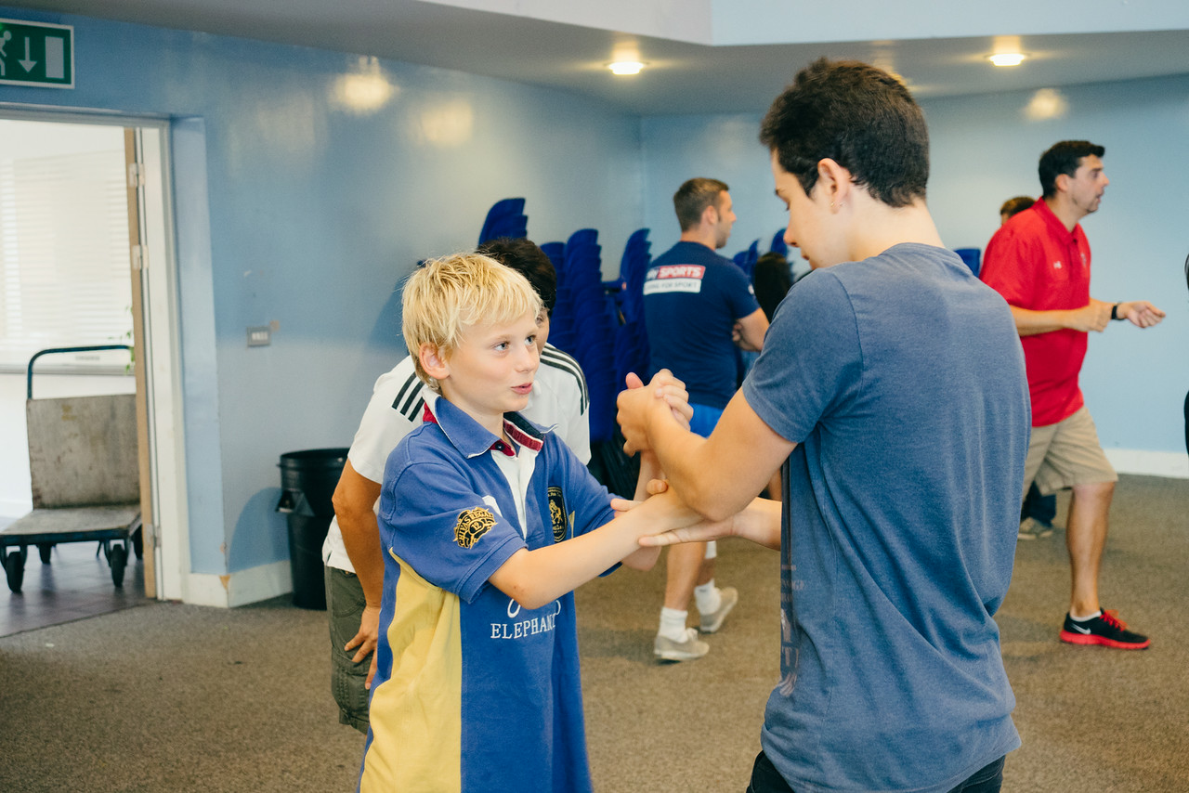
Good morning!

Slide 5
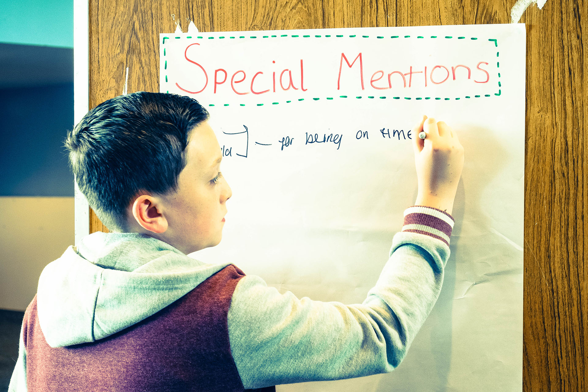
Special Mentions!
Rewarding
positive behaviour

Slide 6
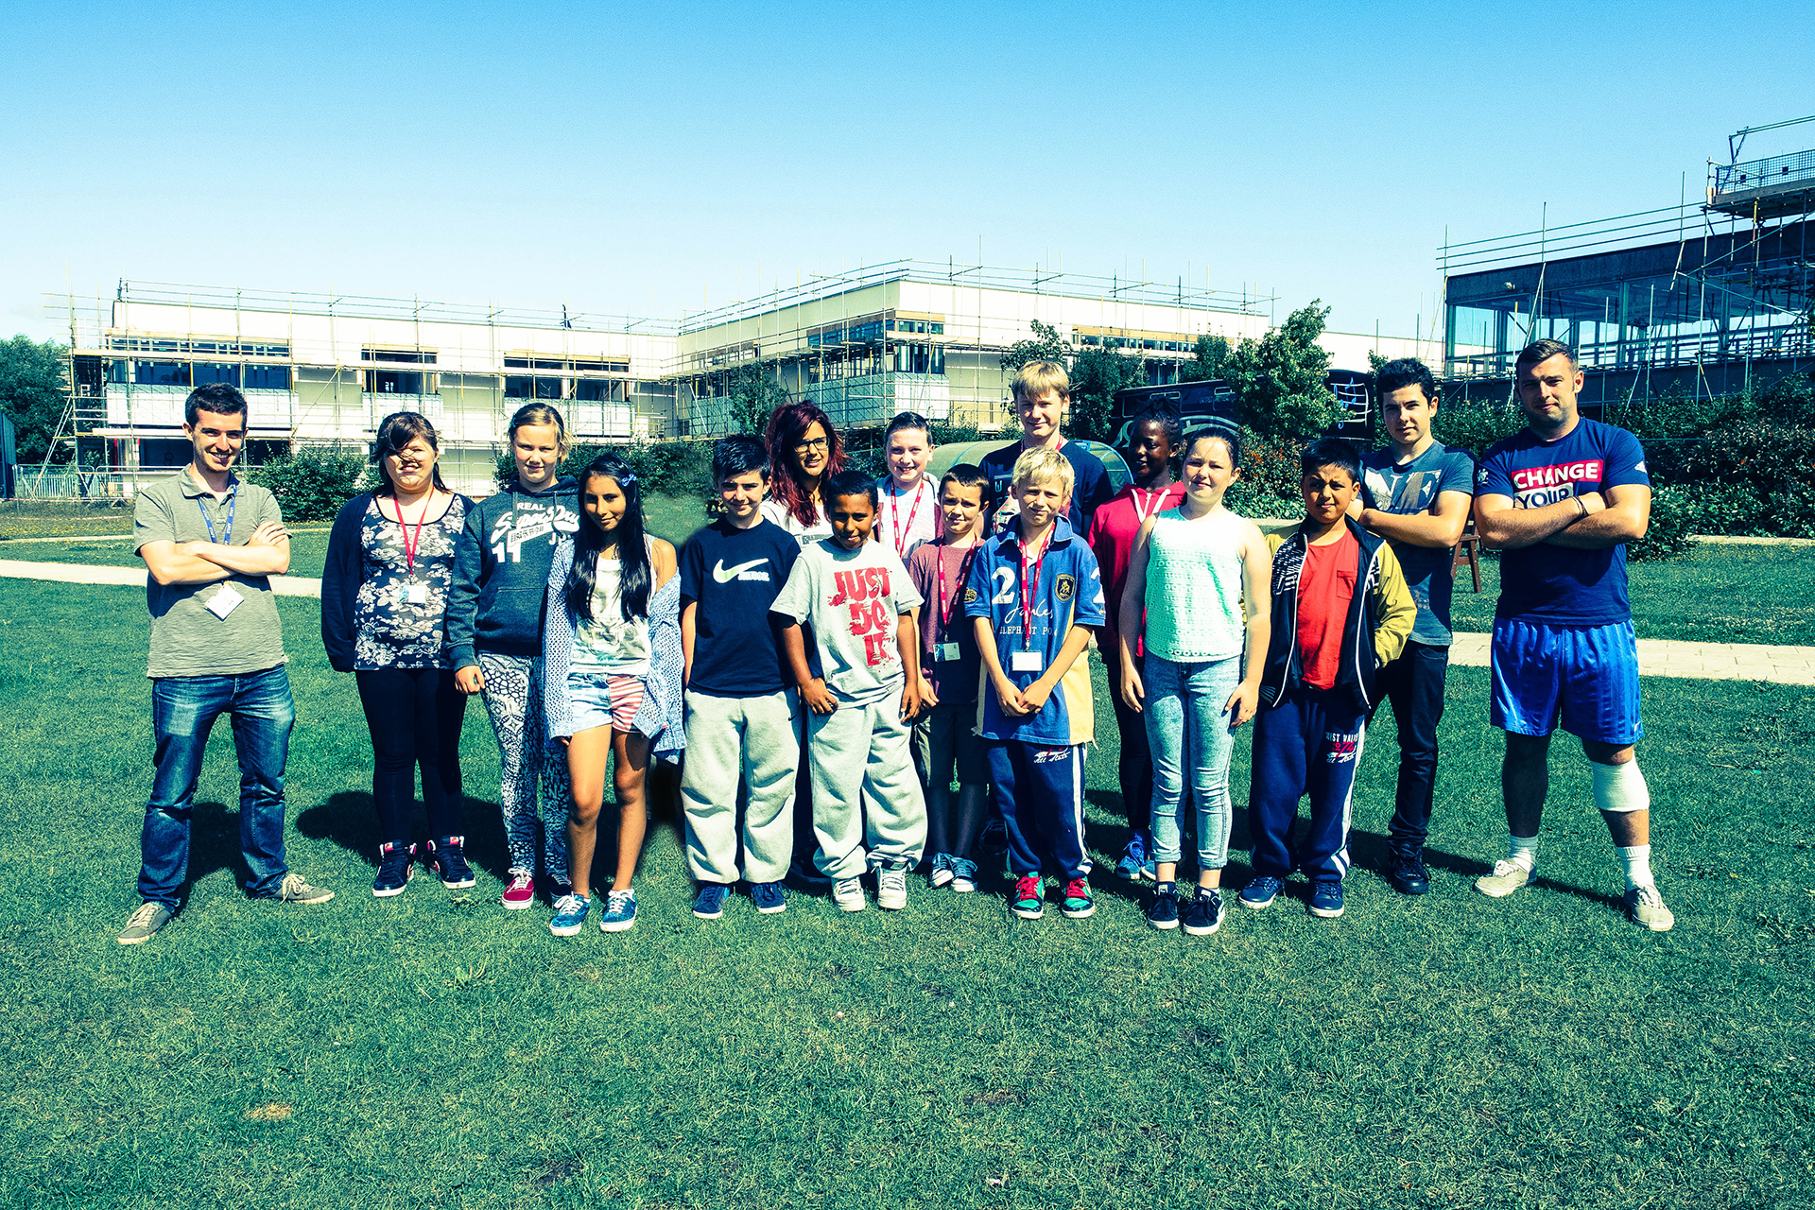
STRETCH
PANIC
COMFORT
Transition can be scary!
How did you feel on your first day?

Slide 7
Outcomes
All explain your role as a Mentor
All identify the key skills pupils need in Year 7
Many explain the mentoring process (4Rs)
Some begin to plan a mentoring task

Slide 8
Summer School helps Year 7 pupils feel confident about the move to secondary school and develop the skills they will need to be successful

Slide 9
What happens at Summer School?
Pupils:
Find their way around
Make new friends
Try exciting activities
Develop skills to help in Year 7
Improve their confidence
Meet a famous person!

Slide 10
Why me?
You care!
You enjoy working with adults and children
You want to make a difference
You believe you can improve yourself
You have experienced transition and survived!

Slide 11
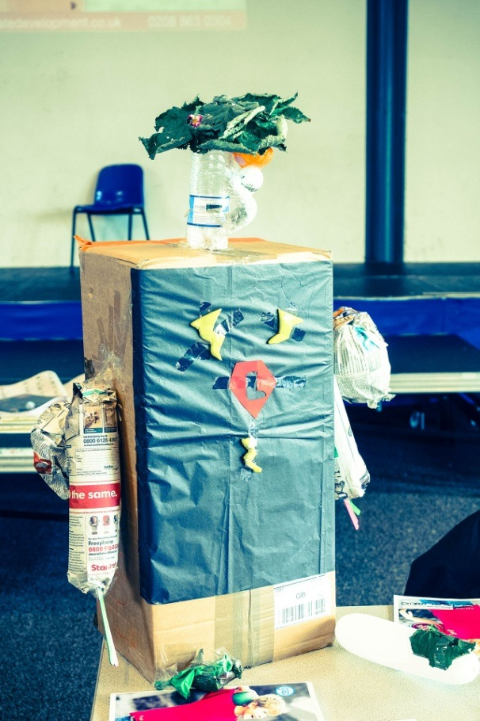
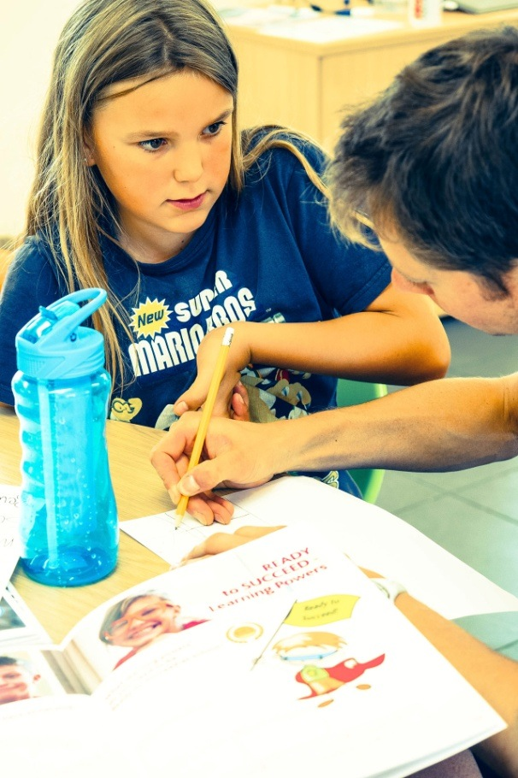
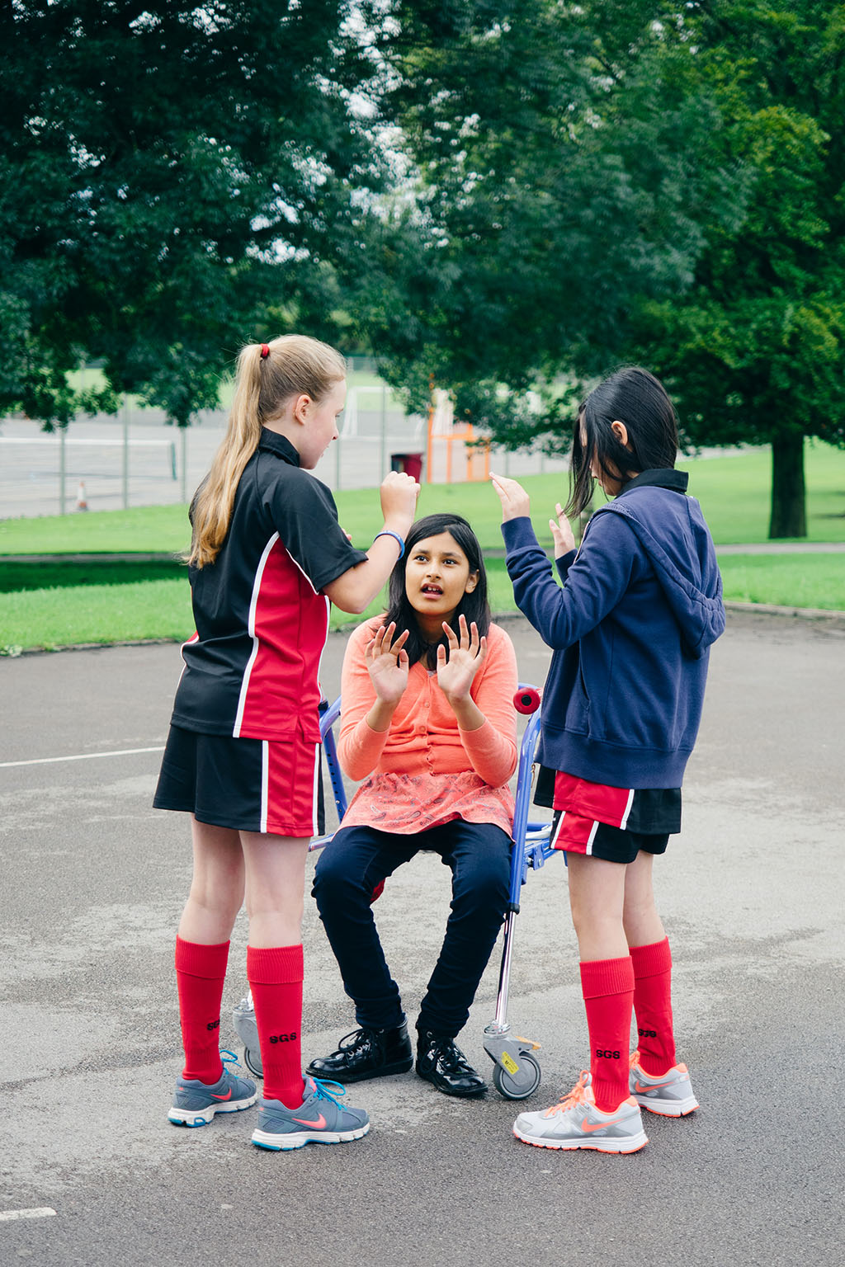
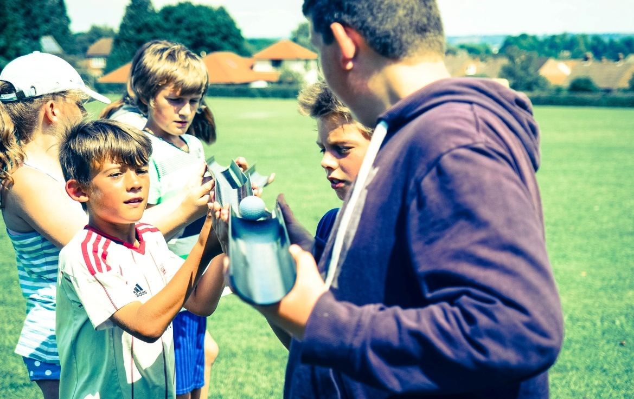
Art and crafts
Outdoor activities
Team challenges

Slide 12
What will
I do?
Work with 3-6 Year 7 pupils
Praise, encourage and help pupils to think and reflect during activities
Help pupils to recognise and record progress
Lead short activities with a clear purpose
Help with daily duties e.g. organising lunch, writing blogs and producing videos

Slide 13
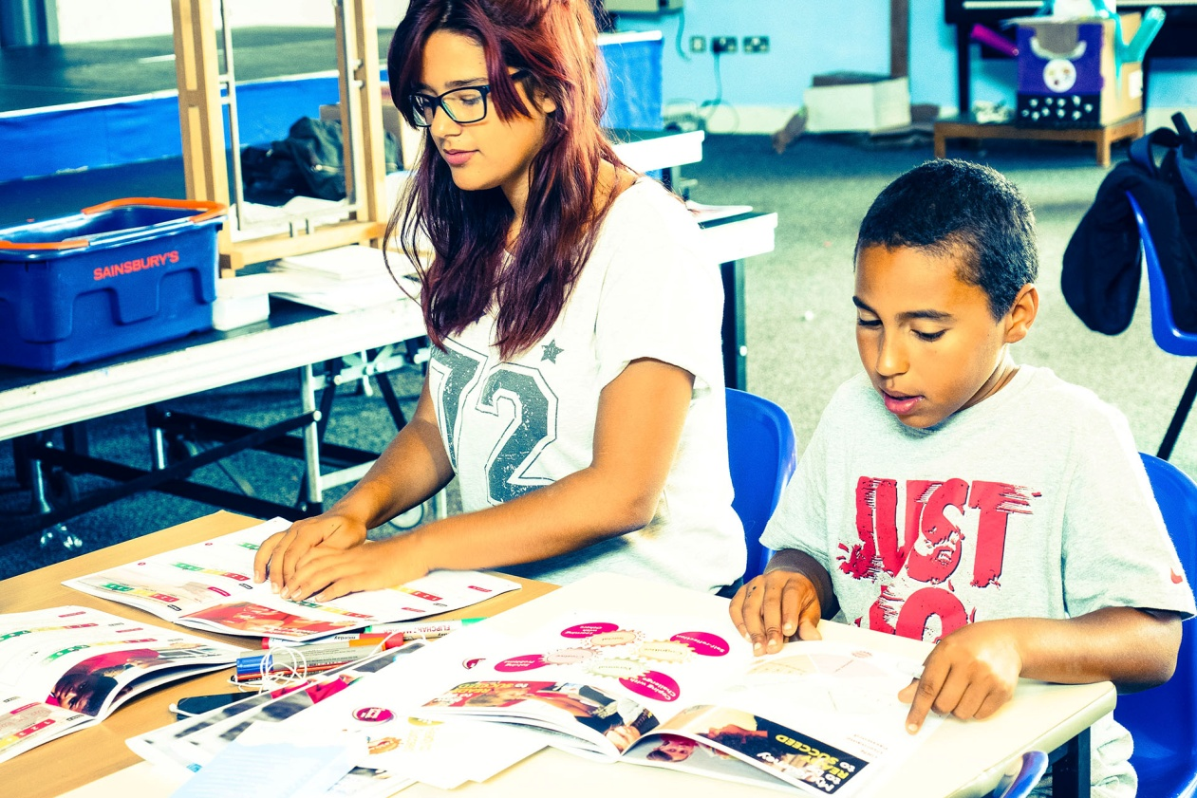
How could this benefit you?

Slide 14
Hopes & Hurdles?

Slide 15
Refocus!
Work well with others.
What might I see or hear if you are?
All ?
Many ?
Some ?
Few ?

Slide 16
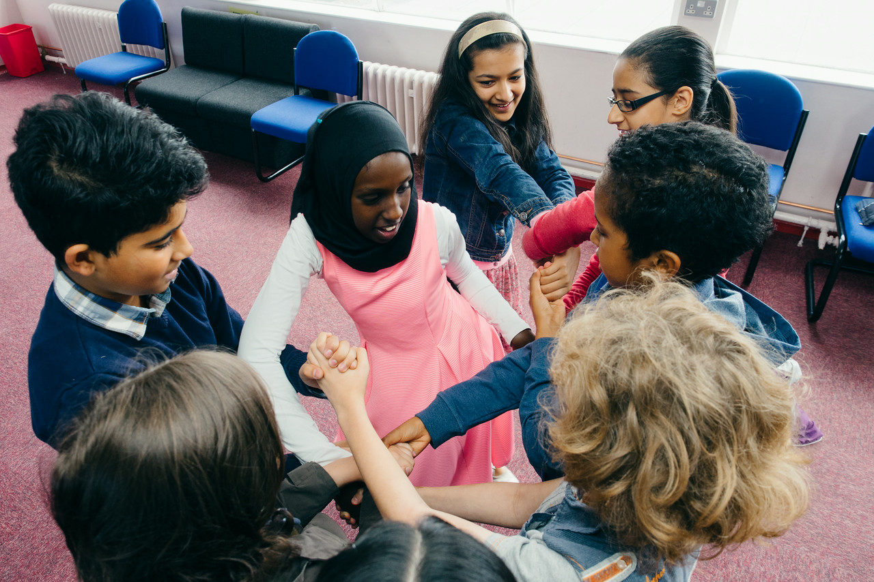
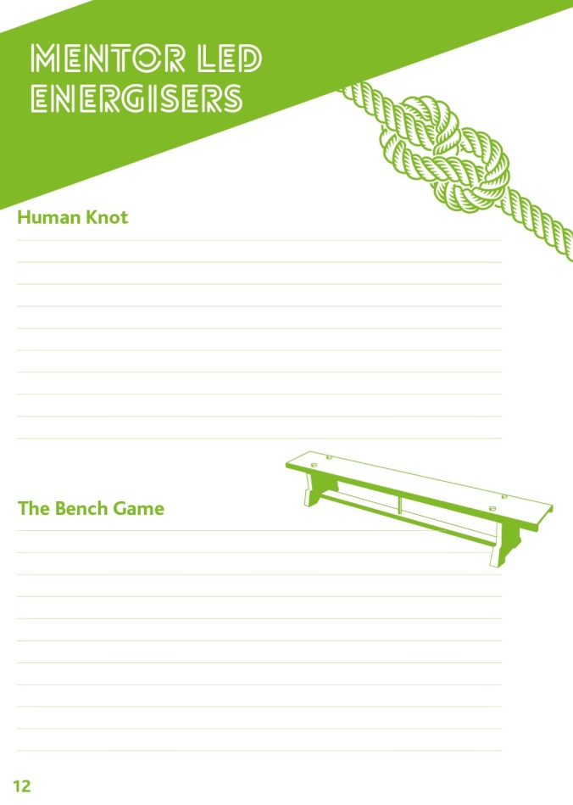
Human Knot

Slide 17
Which essential role did you play?
Driver? Led the group
Engine? Motivated others
Steering wheel? Directed and organised others
Lights? Came up with solutions
Brakes? Got others to think before doing

Slide 18
We need outstanding role models!

Slide 19
Expectations of a Summer School Mentor
Rarely Sometimes Always

Slide 20
Pair and share
Did you enjoy the activity and why?
Would everyone enjoy it?
Would you deliver this energiser on Day 1?

Slide 21
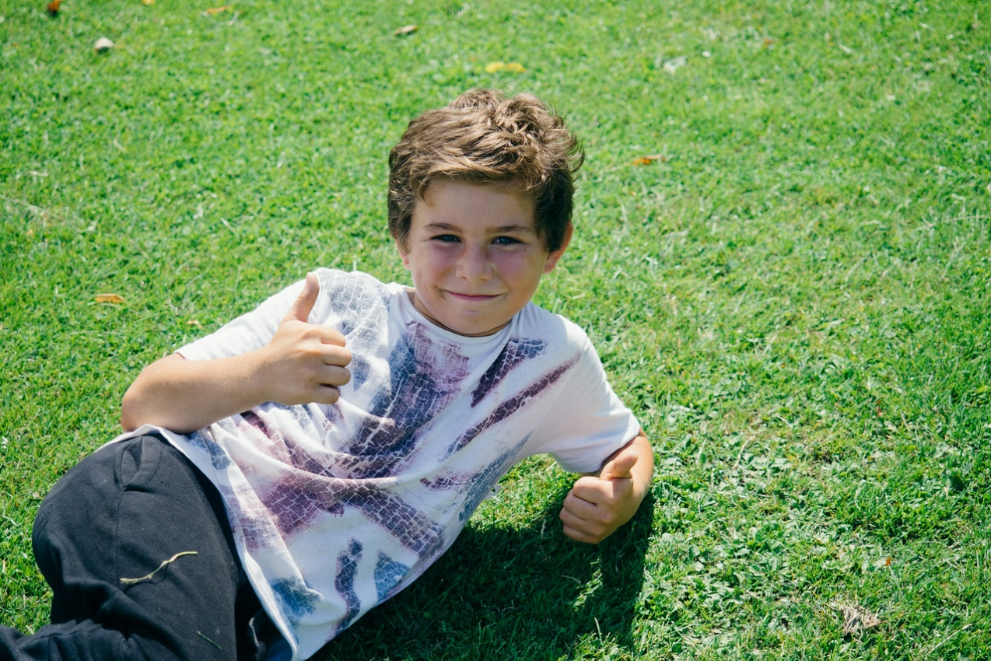
Break
Break

Slide 22
Refocus!
Cope with challenge!
All be willing to have a go
Many try several times if you don't succeed
Some enjoy stretching yourself
Few see mistakes as part of learning

Slide 23
Activity

Slide 24
Review
Choose a review method appropriate for Team Juggling.Think of some questions and practise on another group.

Slide 25
Skills to be successful?
Break

Slide 26
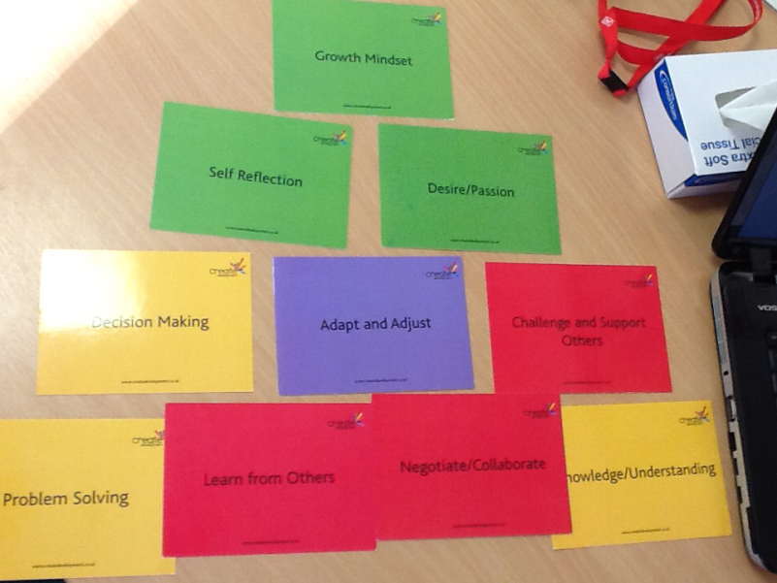
Card Sort
Select the 10 most important skills/Learning Powers to…
Be an outstanding Mentor and role model
Be successful in Year 7?

Slide 27
Cog Theory

Slide 28
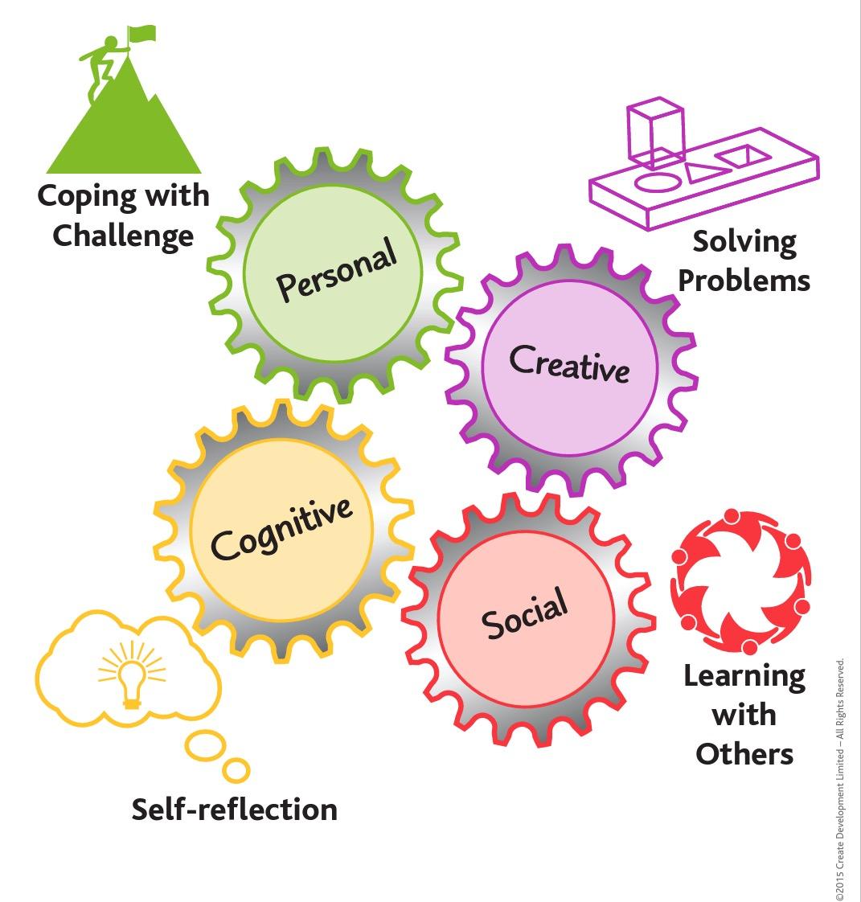
For Year 7s?

Slide 29
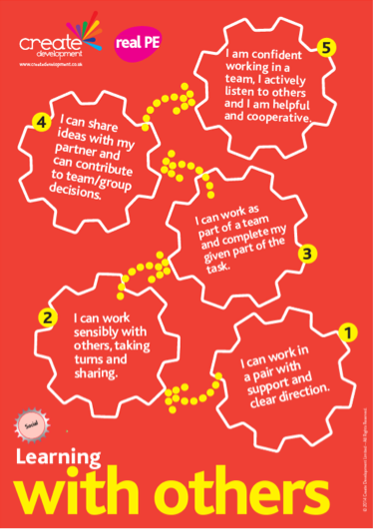
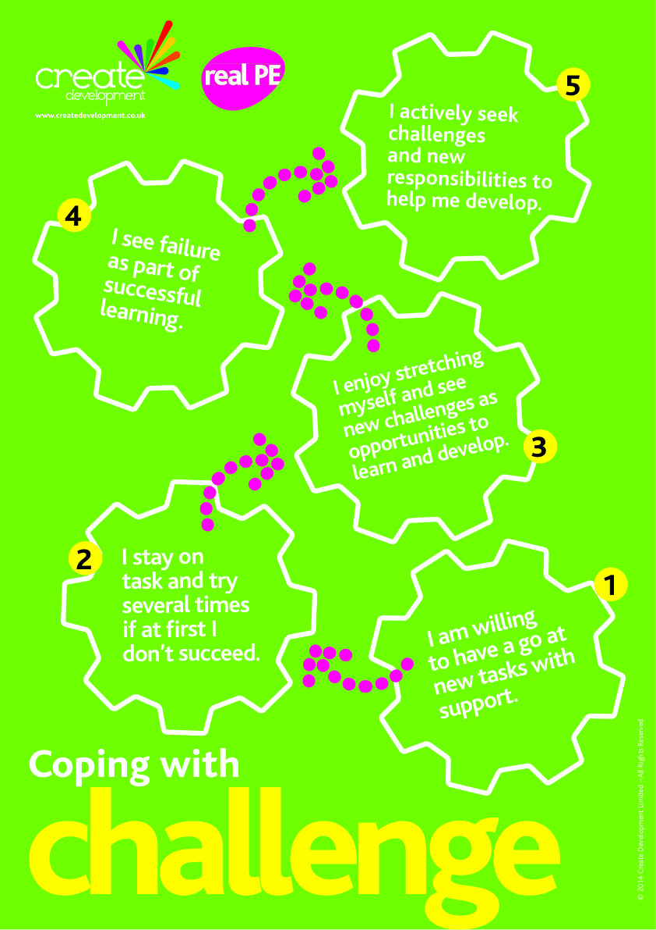
Booklets
in groups
take coping with challenge What do these look and sound like
see hear feel?

Slide 30
Booklets
in groups
take coping with challenge What do these look and sound like
see hear feel?

Slide 31
Mentoring Task
REFOCUS!
Get into groups of 3-5
Choose and read one stage/statement
Discuss what it could mean
Discuss what you might see a pupil do if they were really good at it
Discuss what you might hear a pupil say if they were really good at it

Slide 33
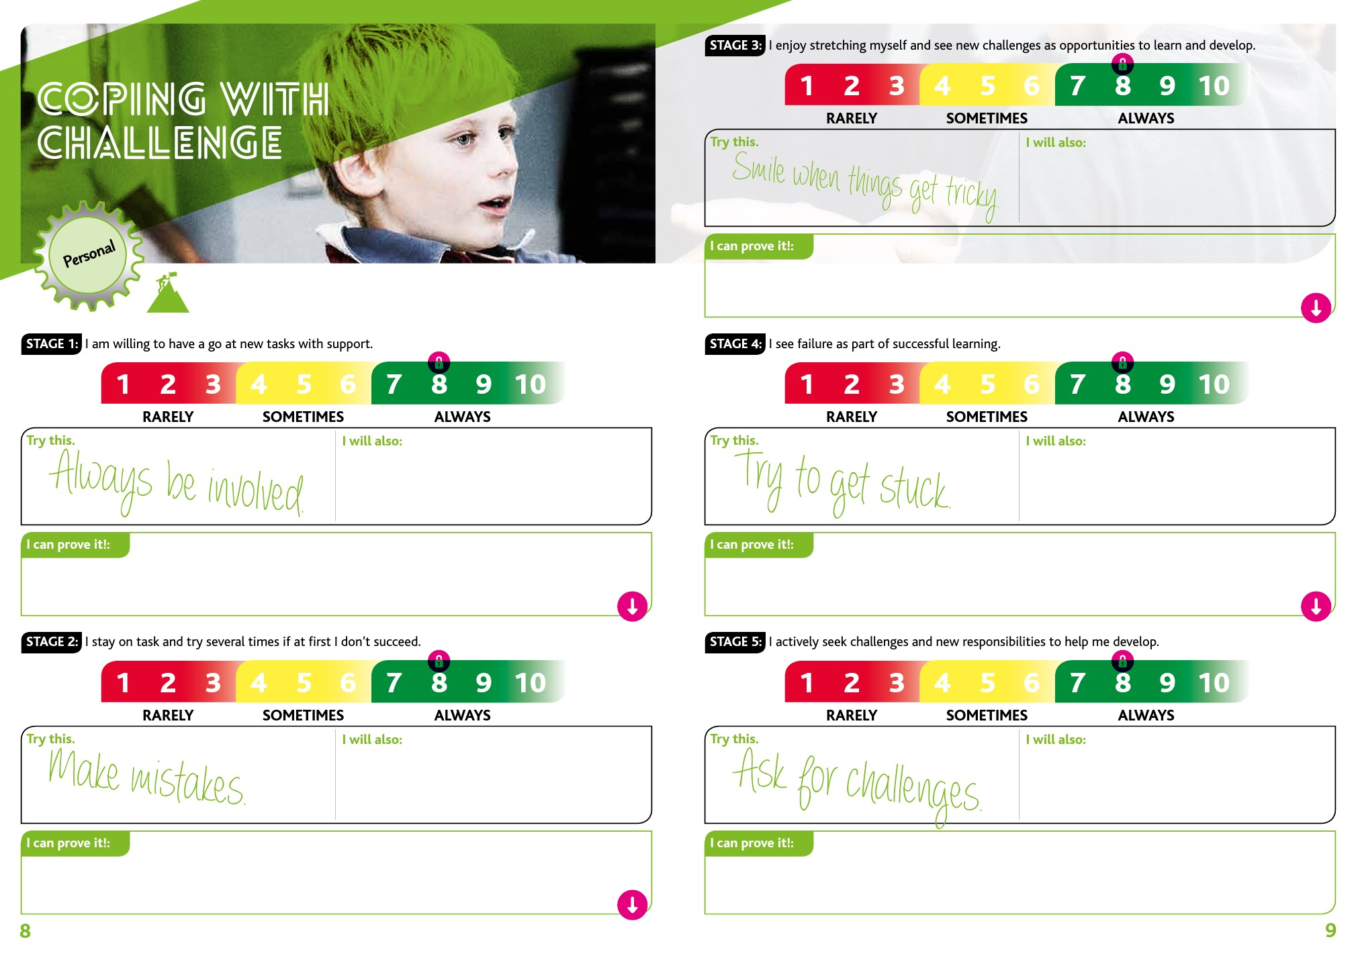
Read page 8 and 9 of the PUPIL Booklet. How do you think this works? What would a pupil do? What is your role?

Slide 34
Time-shares
What is Summer School about? Has your view changed today? How?
What is the role of a Summer School Mentor? Has your view changed? How?
Name a learning power/ability you will need to be a great Mentor and why?

Slide 35
Lunch

Slide 37
4 Rs of
Mentoring
Reward
Review
Refocus
Record

Slide 38
4 Rs of
Mentoring
Refocus before and during activity
Reward with special mentions
Review during and after activity
Record after activity
Discuss how we did this

Slide 39
Planning to
Mentor
Find a partner
Pick an activity (Pages 12-16)
Plan your refocus (Coping with Challenge)
Plan how you will reward
Plan your review (Pages 20-21)
Plan how you will get your participants to record their progress.

Slide 40
Refocus!

Slide 41
Planning to
Mentor
In your pair find 2 more pairs
1 pair lead and mentor
1 pair participate
1 pair review and feedback

Slide 42
Feedback
In your pair find 2 more pairs
1 pair lead and mentor
1 pair participate
1 pair review and feedback

Slide 43
Review
Feedback sandwich
SPECIFIC PRAISE
SPECIFIC AREA FOR
IMPROVEMENT
GENERAL PRAISE

Slide 44
Extreme
Rock-Paper-Scissors

Slide 45
iiMovie

